Slide 1

The data class
Fork and clone repository
https://git.aspp.school/ASPP/2024-heraklion-data.git
Pietro Berkes & Verjinia Metodieva

Slide 2
Things one thinks about when thinking about data
Processing
Storage
Reproducibility and collaboration
Efficient processing (no for-loops!)
Organizing data so that analyses are easy
Size
Access ease
Access time
Versioning
Lineage tracing (which script / other data was used to generate this?)
Ease of sharing

Slide 3
Things one thinks about when thinking about data
Processing
Storage
Reproducibility and collaboration
Efficient processing (no for-loops!)
Organizing data so that analyses are easy
Size
Access ease
Access time
Versioning
Lineage tracing (which script / other data was used to generate this?)
Ease of sharing

Slide 4

Hands-on What data structure would you use to represent…

Slide 5
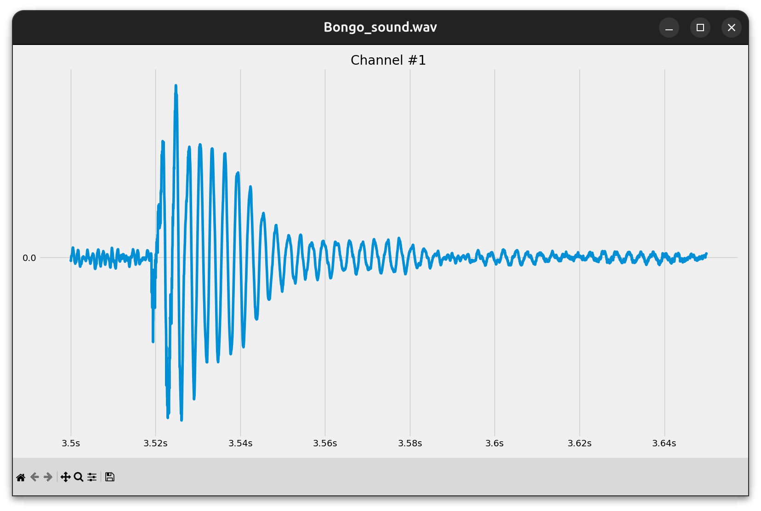
Hands-on What data structure would you use to represent…
A sound wave?

Slide 6
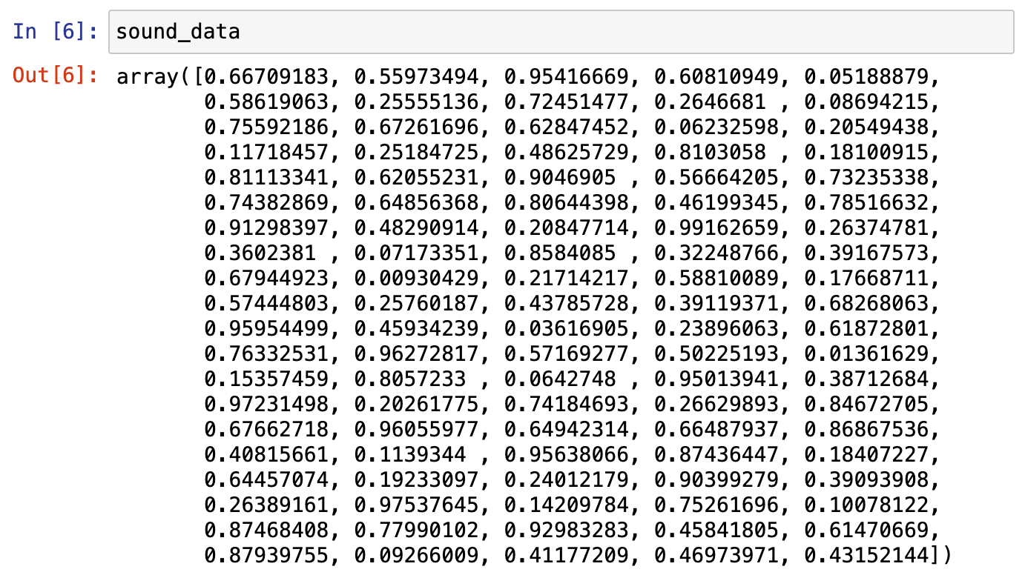
Hands-on What data structure would you use to represent…
A sound wave?
NumPy array

Slide 7
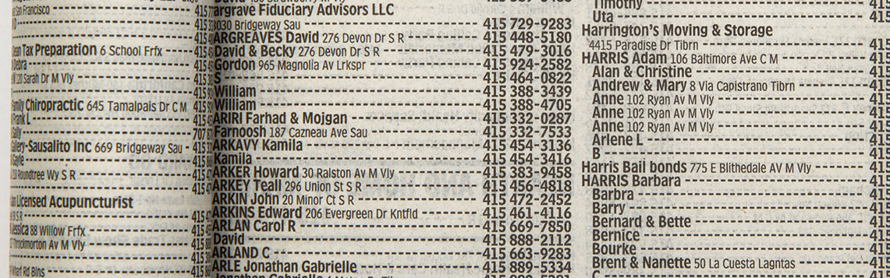
Hands-on What data structure would you use to represent…
Phone book entries?

Slide 8
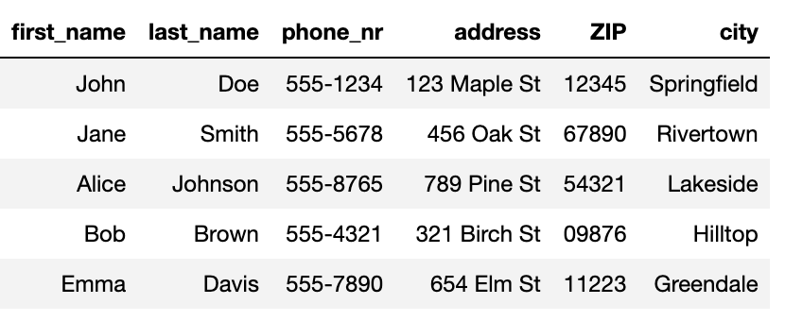
Hands-on What data structure would you use to represent…
Phone book entries?
Pandas DataFrame

Slide 9





Hands-on What data structure would you use to represent…
Friendship relations?

Slide 10
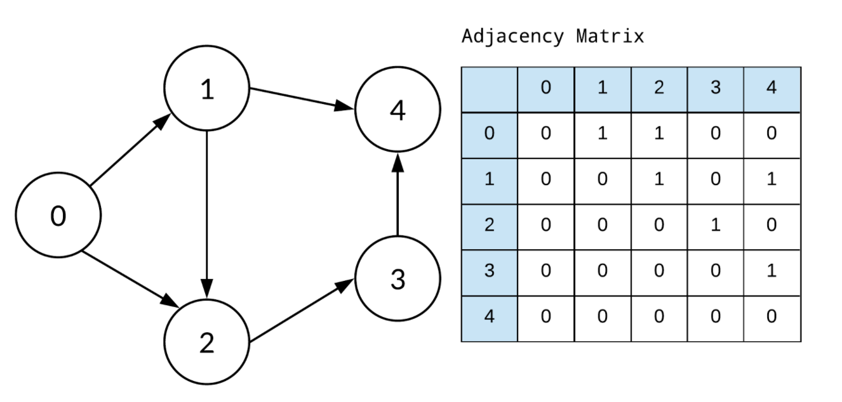
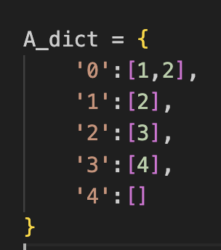
Hands-on What data structure would you use to represent…
Implemented as
Friendship relations?
Graph
Adjacency matrix (array)
Dictionary

Slide 11
You develop your code on a small data set, how is it going to scale to the complete data set?
Development data
Real data
N data points,
Processing time T
10x N data points
Processing time -> ?
We’re interested in orders of magnitude
Notes:
Data and code are related.
Nice transition from the last question. In extreme case, when the relations in the graph are dynamic/ changing a lot →using a dictionary is not a good solution. Instead, when small dataset and we are mainly interested in visualizing the relations, it might be.
The NumPy array solutions, scales much better, in case there are hundreds of dynamically changing relations to inspect.

Slide 12
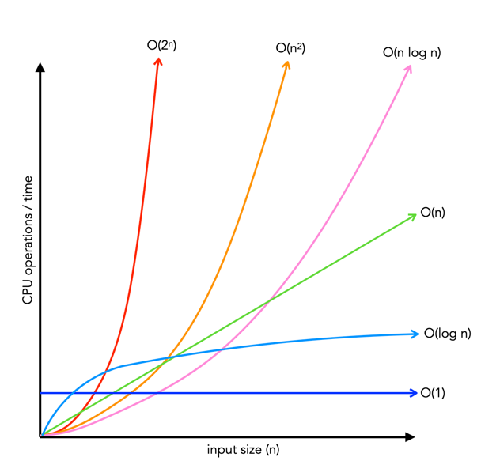
How performance scales: big-O
Big-O class | What we call it | Time increase, when data increases 10x
O(1) | constant | 1x time
O(n) | linear | 10x time
O(n²) | quadratic | 100x time
O(n * log n) | linearithmic | ~10-20x time
O(log n) | logarithmic | ~1-2x time
O(2^{n})
O(n²)
O(n log n)
O(n)
Time
O(log n)
O(1)
Input size, n

Slide 13
Hands-on: Operations on lists
Big-O class | What we call it | Time increase, when data increases 10x
O(1) | constant | 1x time
O(n) | linear | 10x time
O(n²) | quadratic | 100x time
O(n * log n) | linearithmic | ~10-20x time
O(log n) | logarithmic | ~1-2x time
O(2^{n})
O(n²)
O(n log n)
O(n)
Time
Big-O class | Operation on lists that scales this way
O(1)
O(n)
O(n²)
O(n * log n)
O(log n)
O(log n)
O(1)
Input size, n

Slide 14
Hands-on: Operations on lists
Big-O class | What we call it | Time increase, when data increases 10x
O(1) | constant | 1x time
O(n) | linear | 10x time
O(n²) | quadratic | 100x time
O(n * log n) | linearithmic | ~10-20x time
O(log n) | logarithmic | ~1-2x time
O(2^{n})
O(n²)
O(n log n)
O(n)
Time
Big-O class | Operation on lists that scales this way
O(1) | Getting an element by its index
O(n) | Summing elements in list
O(n²) | Computing distance between all pairs of elements in the list
O(n * log n) | Sorting the list
O(log n) | Searching an element in a sorted list
O(log n)
O(1)
Input size, n

Slide 15
Example: Find common words
Given two lists of words, extract all the words that are in common
Expected result: ['apple', 'orange', 'banana']

Slide 16
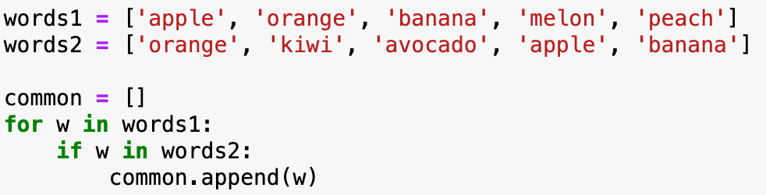
Implementation with two for-loops
What is the big-O complexity of this implementation?

Slide 17
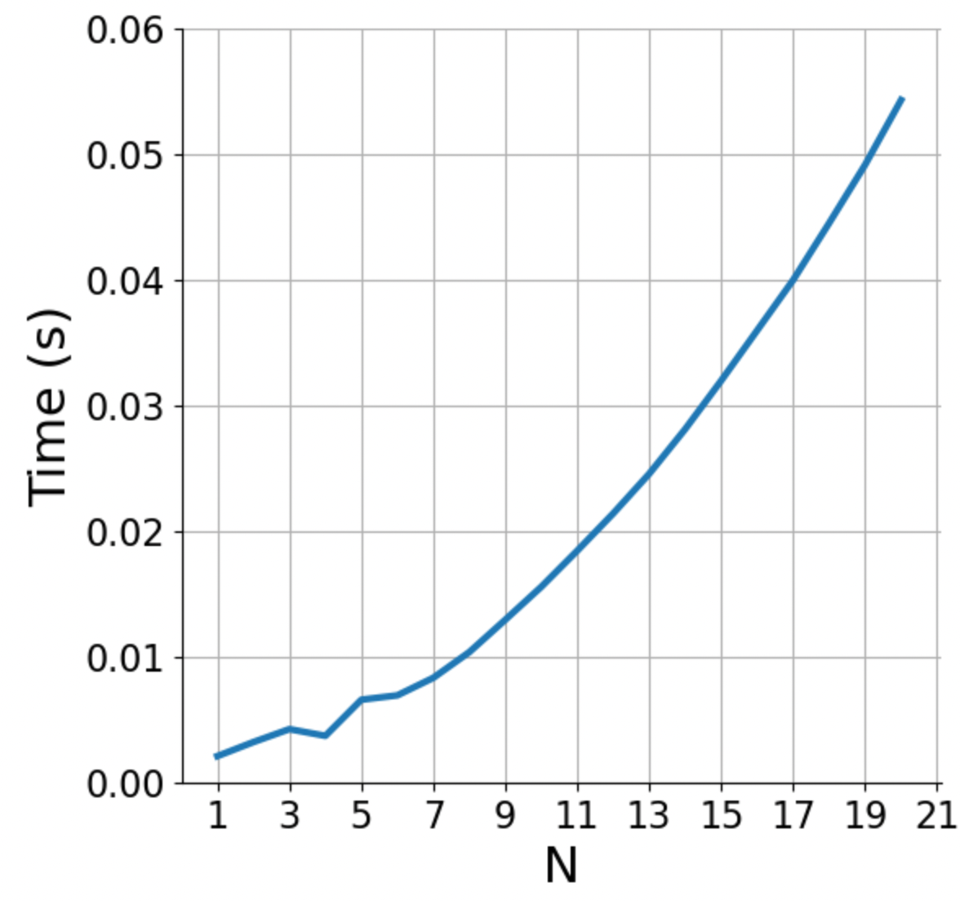
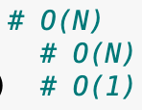
Implementation with two for-loops
What is the big-O complexity of this implementation?
N * N ~ O(N²)

Slide 18
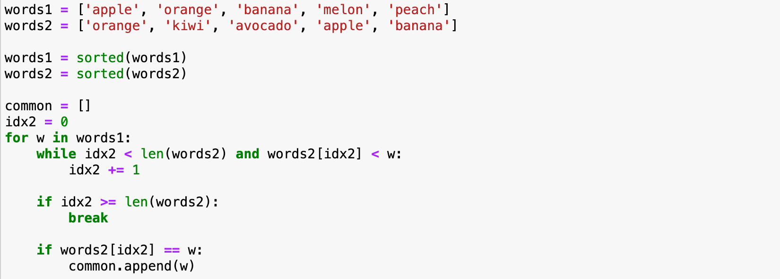
Implementation with sorted lists
What is the big-O complexity of this implementation?

Slide 19
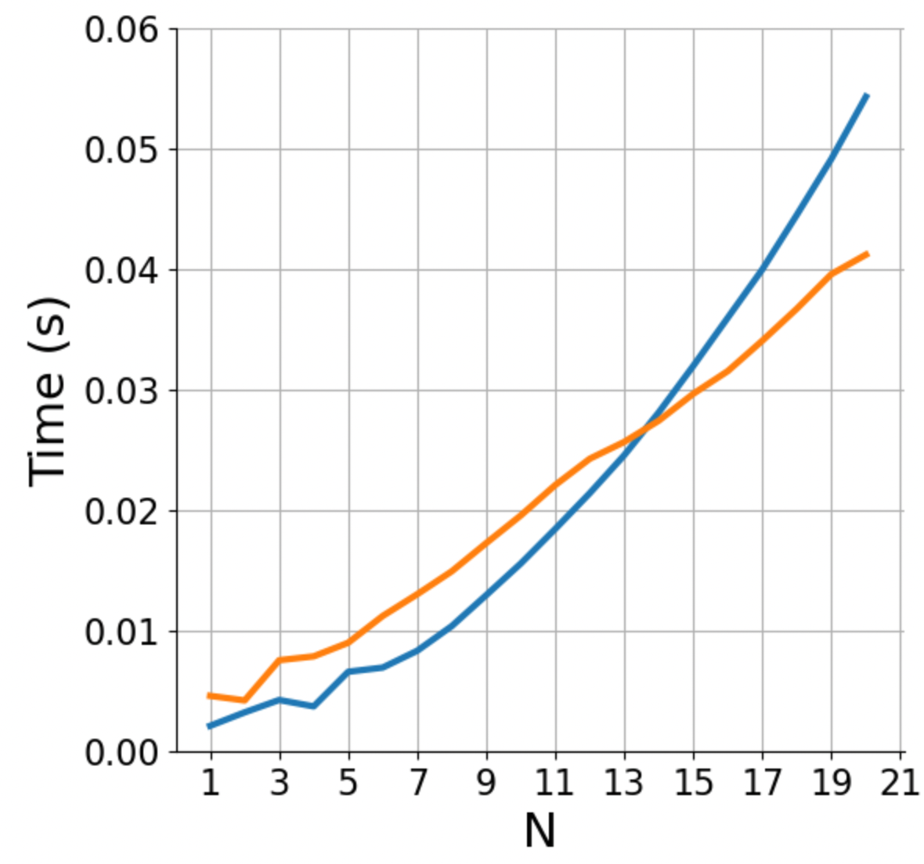

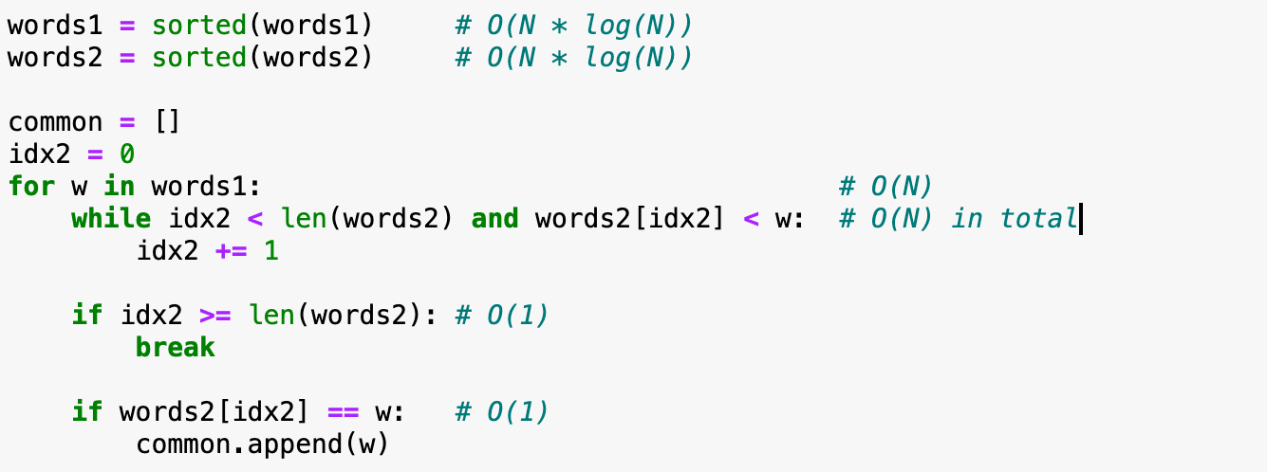
Implementation with sorted lists
What is the big-O complexity of this implementation?
2 * (N * log(N)) + 2 * N ~ O(N log N)

Slide 20
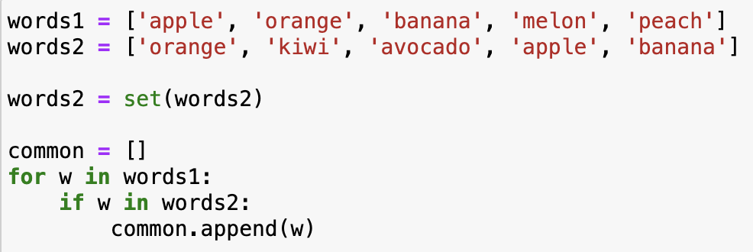
Implementation with sets
What is the big-O complexity of this implementation?

Slide 21
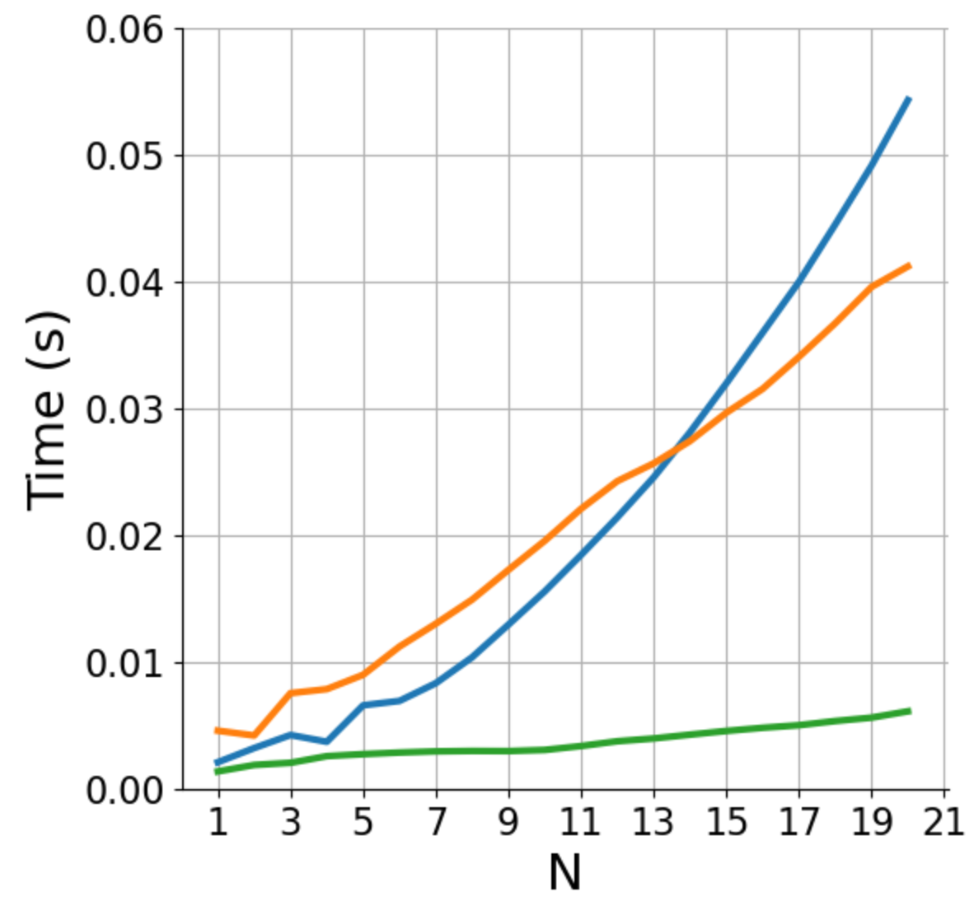
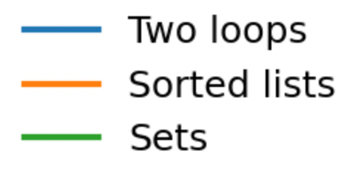
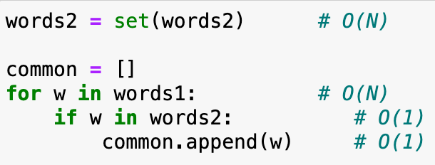
Implementation with sets
What is the big-O complexity of this implementation?
N + N ~ O(N)

Slide 22
Basic reference sheet about Python data structures
Lists: collection of ordered, arbitrary data
Dictionaries (“hashmaps”)
Inserting | O(1)
Finding a value by key (e.g., “if element in my_dict: …”) | O(1)
Getting an element by index | O(1)
Appending | O(1)
Inserting an element at index | O(n)
Sorting | O(n log n)
Finding an element (e.g., “if element in my_list: …”) | O(n)
Sets: it’s dictionaries without values
Inserting | O(1)
Finding a value by key (e.g., “if element in my_set: …”) | O(1)
See also: https://wiki.python.org/moin/TimeComplexity
Notes:
Note that there may be different implementations of these data structures with different complexities, these are for the Python implementation.
E.g., if finding an element in a list is important, one could implement it as two dictionaries, one mapping indices to data, one mapping data to indices. Finding out the complexities of all the operations with this implementation is left as a homework.

Slide 23
Hands-on
Exercise
exercises/match_tarots
Open the notebook match_tarots, and follow the instructions!
Submit a PR for Issue #7 on git.aspp.school/ASPP/2024-heraklion-data

Slide 24
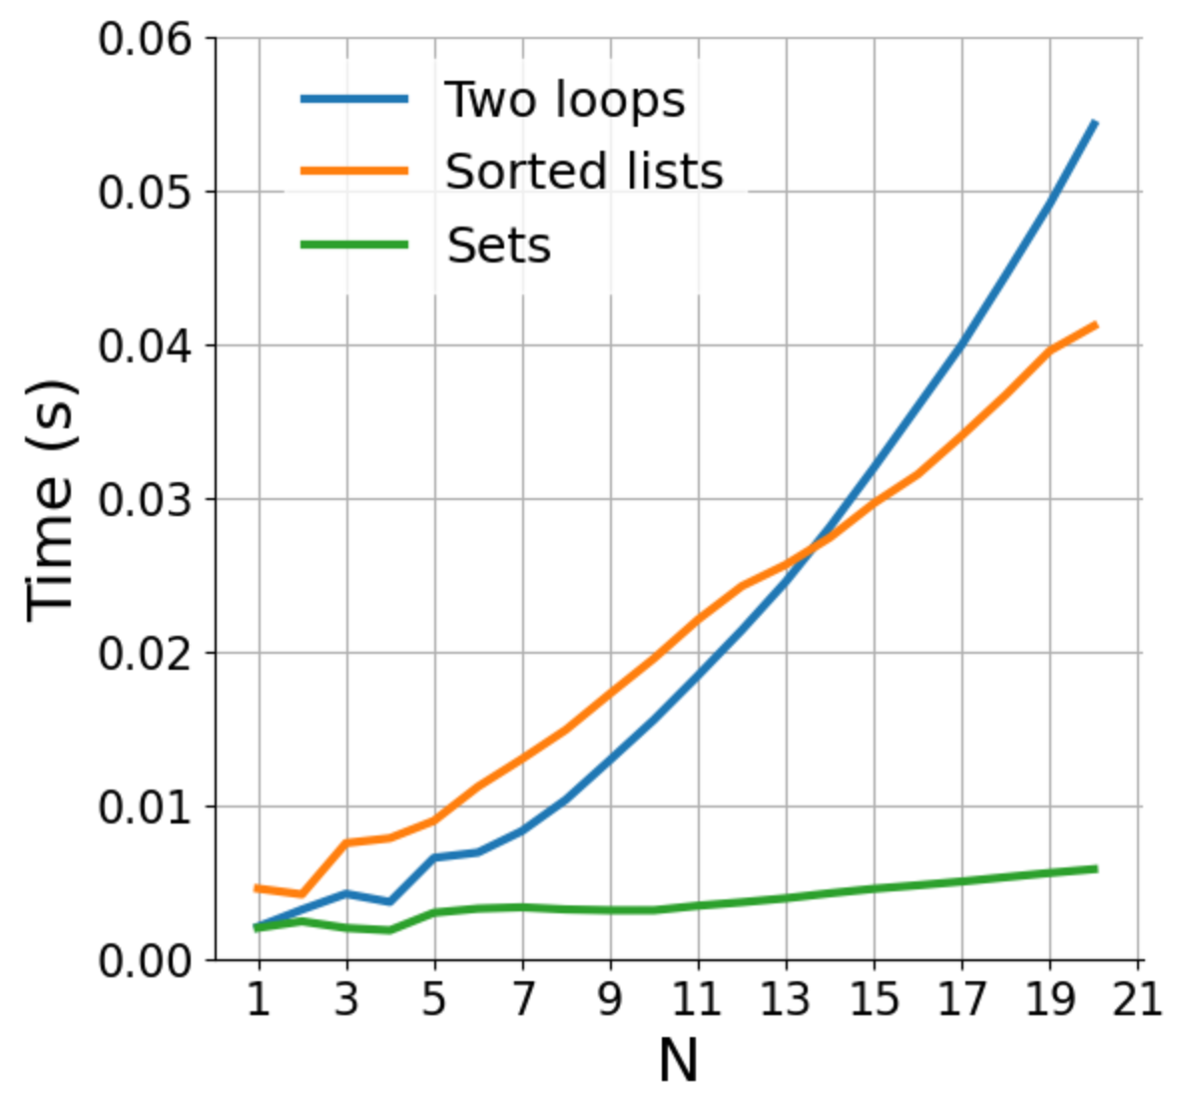

How does rewriting in C change the performance? (rewriting in C, parallelization; same algorithm)
Fast execution
Slow scaling O(n²)
Fast code
O(n²)
Regular code
O(n log n)
Slow execution
Fast scaling O(n log n)
Notes:
Parallelization lowers the curves.
For a fixed code, linear code is no necessarily faster.
Important when n is growing
Parallelization/ optimization → you can make the code faster for any fixed N, but the shape (of growth) can never change

Slide 25
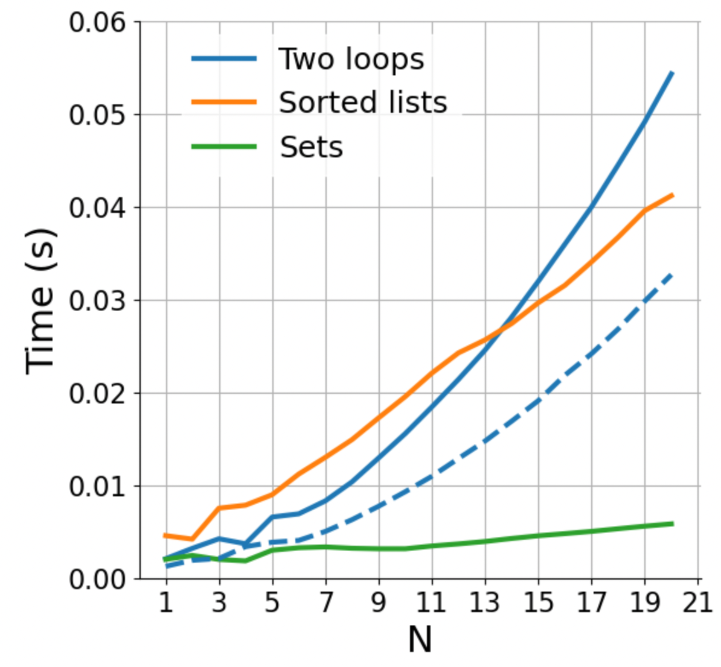
How does rewriting in C change the performance? (rewriting in C, parallelization; same algorithm)
Faster language increases performance for fixed N
Fast code
O(n²)
Regular code
O(n log n)
Notes:
Parallelization lowers the curves.
For a fixed code, linear code is no necessarily faster.
Important when n is growing
Parallelization/ optimization → you can make the code faster for any fixed N, but the shape (of growth) can never change

Slide 26
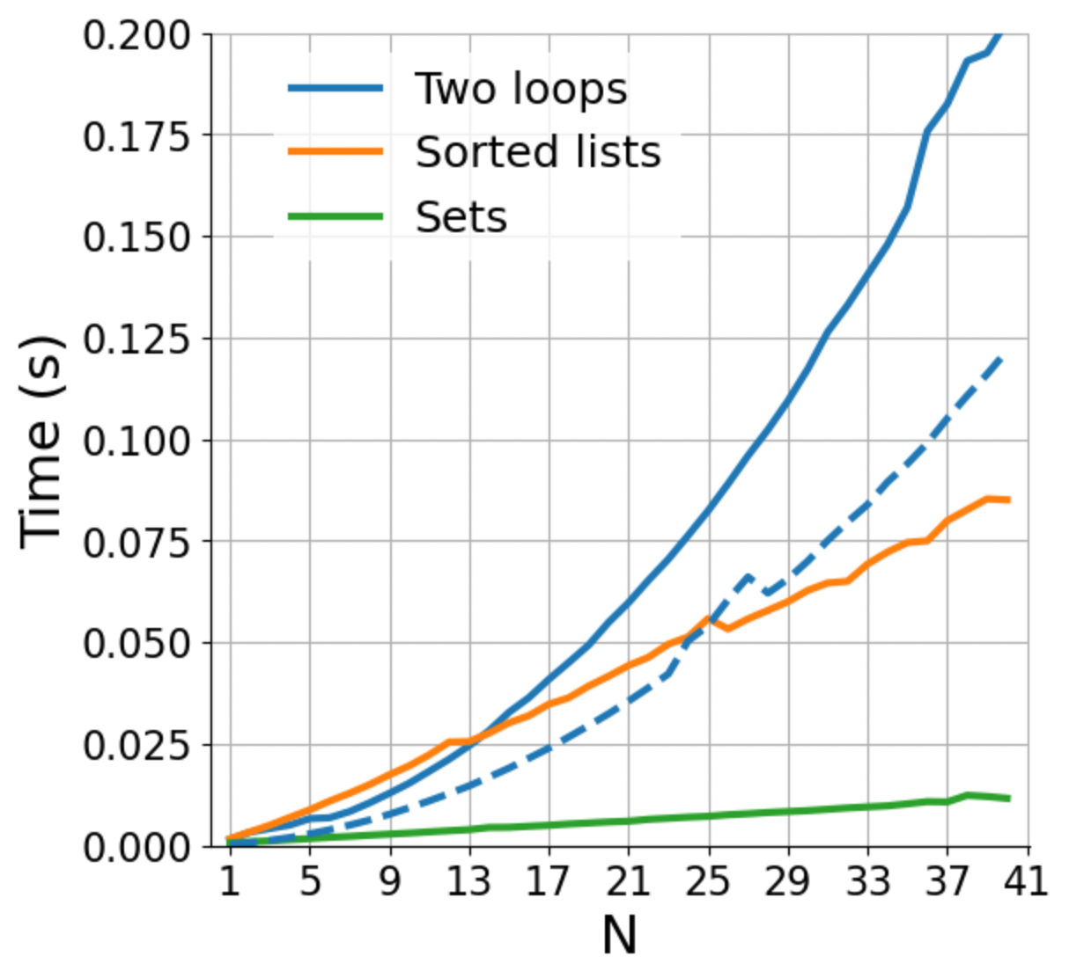
How does rewriting in C change the performance? (rewriting in C, parallelization; same algorithm)
Fast code
O(n²)
Regular code
O(n log n)
Notes:
Parallelization lowers the curves.
For a fixed code, linear code is no necessarily faster.
Important when n is growing
Parallelization/ optimization → you can make the code faster for any fixed N, but the shape (of growth) can never change

Slide 27
How does rewriting in C change the performance? (rewriting in C, parallelization; same algorithm)
Fast code
O(n²)
We need to distinguish between “fast” in absolute terms for a fixed problem size, and “fast” in the sense of how well it scales
Regular code
O(n log n)
Notes:
Parallelization lowers the curves.
For a fixed code, linear code is no necessarily faster.
Important when n is growing
Parallelization/ optimization → you can make the code faster for any fixed N, but the shape (of growth) can never change

Slide 28
COMING UP NEXT: NumPy and the array data structure

Slide 29

NumPy

Slide 30

NumPy – huh, yeah – what’s it good for?
Introduces new data structure: the array
An array is a regular, N-dimensional grid of data of the same type, typically numerical data

Slide 31
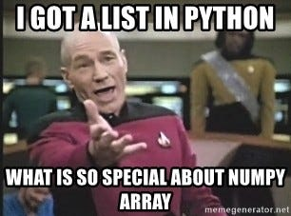
NumPy – huh, yeah – what’s it good for?
Introduces new data structure: the array
An array could be represented as a list-of-lists
Why are NumPy arrays better than a list-of-lists?
**Computer architecture class**
An array is a regular, N-dimensional grid of data of the same type, typically numerical data

Slide 32
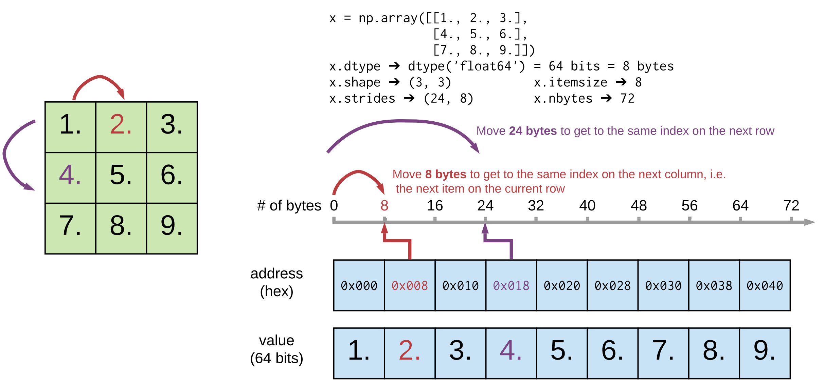
Efficiency of NumPy
Memory:
data occupies the minimum amount of memory required
some operations can be done without touching the memory at all!
Notes:
The standard Python implementation is written in C. This means that every Python object is simply a cleverly-disguised C structure, which contains not only its value, but metadata as well
a C integer is essentially a label for a position in memory whose bytes encode an integer value. A Python integer is a pointer to a position in memory containing all the Python object information, including the bytes that contain the integer value
NumPy handles looping over array elements near-optimally—for example, taking strides into consideration to best utilize the computer’s fast cache memory
NumPy array - single pointer to one contiguous block of data
The Python list, on the other hand, contains a pointer to a block of pointers, each of which in turn points to a full Python object

Slide 33
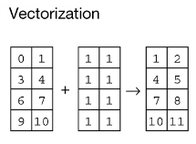
Efficiency of NumPy
Memory:
data occupies the minimum amount of memory required
some operations can be done without touching the memory at all!
Speed:
Many operations can be done very efficiently in C. For this to be useful, we need to avoid Python for-loops at all costs!
operating on entire arrays rather than their individual elements
→ “vectorize” the code
Notes:
Speed
Not only efficient storage of data but also
NumPy package comes with a efficient operations on the data done efficiently in C
Option (usually forced, when using NumPy) to operate on entire arrays rather than on their individual elements

Slide 34

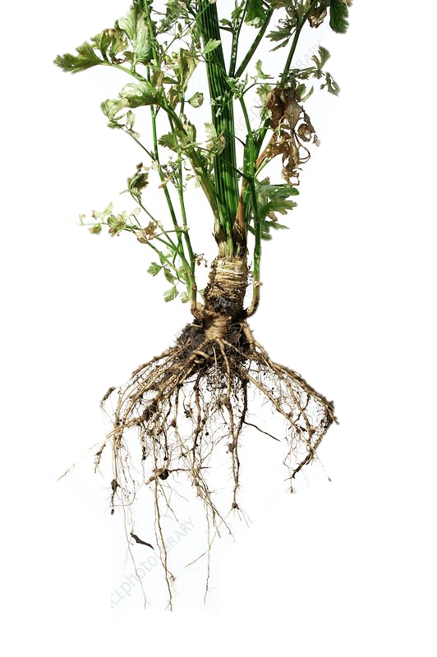
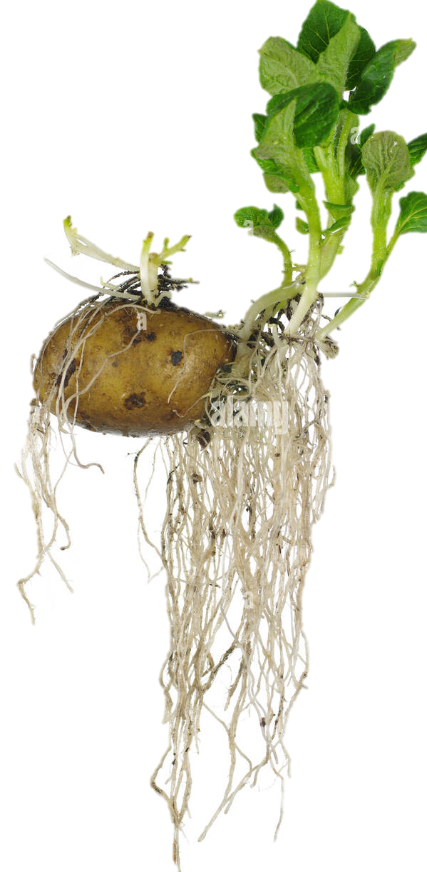

NumPy’s memory efficiency

Slide 35
Memory block
The array data is stored in a contiguous memory block, using native data types
0 | 1 | 2 | 3 | 4 | 5 | 6 | 7 | 8
int64

Slide 36
Memory block
0 | 1 | 2 | 3 | 4 | 5 | 6 | 7 | 8
int64
8 bytes
24 bytes
NumPy array metadata
dtype | int64
ndim | 2
shape | (3, 3)
strides | (24, 8)

Slide 37
Memory block
0 | 1 | 2 | 3 | 4 | 5 | 6 | 7 | 8
Metadata tells NumPy how to interpret the memory block
int64
8 bytes
24 bytes
NumPy array metadata
dtype | int64
ndim | 2
shape | (3, 3)
strides | (24, 8)

Slide 38

Memory block
0 | 1 | 2 | 3 | 4 | 5 | 6 | 7 | 8
Metadata tells NumPy how to interpret the memory block
int64
8 bytes
24 bytes
NumPy array metadata
dtype | int64
ndim | 2
shape | (3, 3)
strides | (24, 8)

Slide 39

Memory block
0 | 1 | 2 | 3 | 4 | 5 | 6 | 7 | 8
Metadata tells NumPy how to interpret the memory block
int64
8 bytes
24 bytes
NumPy array metadata
NumPy view
dtype | int64
ndim | 2
shape | (3, 3)
strides | (24, 8)
0 | 1 | 2
3 | 4 | 5
6 | 7 | 8

Slide 40
Memory block
0 | 1 | 2 | 3 | 4 | 5 | 6 | 7 | 8
The same memory block can be interpreted in many ways
NumPy operation
NumPy view
0 | 1 | 2
3 | 4 | 5
6 | 7 | 8
x
x.ravel()
0 | 1 | 2 | 3 | 4 | 5 | 6 | 7 | 8
0 | 3 | 6
1 | 4 | 7
2 | 5 | 8
x.T
0 | 2
6 | 8
x[::2, ::2]
Notes:
The same memory block can be interpreted in many ways → that means that there are operations that cost nothing because they only change the metadata
NumPy view and operations
Operations that require no time at all because noting is changing , only the metadata
Any operation that only needs to change the metadata. NumPy very efficient
Every time it can, it can only change thet metadata
Operations that can only change the metadata → return a view (introduce new concept)

Slide 41
Memory block
0 | 1 | 2 | 3 | 4 | 5 | 6 | 7 | 8
The same memory block can be interpreted in many ways
NumPy operation
NumPy view
0 | 1 | 2
3 | 4 | 5
6 | 7 | 8
x
x.ravel()
0 | 1 | 2 | 3 | 4 | 5 | 6 | 7 | 8
0 | 3 | 6
1 | 4 | 7
2 | 5 | 8
x.T
0 | 2
6 | 8
x[::2, ::2]
Notes:
The same memory block can be interpreted in many ways → that means that there are operations that cost nothing because they only change the metadata
NumPy view and operations
Operations that require no time at all because noting is changing , only the metadata
Any operation that only needs to change the metadata. NumPy very efficient
Every time it can, it can only change thet metadata
Operations that can only change the metadata → return a view (introduce new concept)

Slide 42
Memory block
0 | 1 | 2 | 3 | 4 | 5 | 6 | 7 | 8
The same memory block can be interpreted in many ways
NumPy operation
NumPy array metadata
NumPy view
dtype | int64
ndim | 2
shape | (3, 3)
strides | (24, 8)
0 | 1 | 2
3 | 4 | 5
6 | 7 | 8
x
dtype | int64
ndim | 1
shape | (9,)
strides | (8,)
x.ravel()
0 | 1 | 2 | 3 | 4 | 5 | 6 | 7 | 8
dtype | int64
ndim | 2
shape | (3, 3)
strides | (8, 24)
0 | 3 | 6
1 | 4 | 7
2 | 5 | 8
x.T
dtype | int64
ndim | 2
shape | (2, 2)
strides | (48, 16)
0 | 2
6 | 8
x[::2, ::2]
Notes:
The same memory block can be interpreted in many ways → that means that there are operations that cost nothing because they only change the metadata
NumPy view and operations
Operations that require no time at all because noting is changing , only the metadata
Any operation that only needs to change the metadata. NumPy very efficient
Every time it can, it can only change thet metadata
Operations that can only change the metadata → return a view (introduce new concept)

Slide 43
Memory block
0 | 1 | 2 | 3 | 4 | 5 | 6 | 7 | 8
There are NumPy operations that can be performed just by changing the metadata
NumPy operation
NumPy array metadata
NumPy view
very efficient --> O(1)
dtype | int64
ndim | 2
shape | (3, 3)
strides | (24, 8)
0 | 1 | 2
3 | 4 | 5
6 | 7 | 8
x
dtype | int64
ndim | 1
shape | (9,)
strides | (8,)
x.ravel()
0 | 1 | 2 | 3 | 4 | 5 | 6 | 7 | 8
dtype | int64
ndim | 2
shape | (3, 3)
strides | (8, 24)
0 | 3 | 6
1 | 4 | 7
2 | 5 | 8
x.T
dtype | int64
ndim | 2
shape | (2, 2)
strides | (48, 16)
0 | 2
6 | 8
x[::2, ::2]
Notes:
The same memory block can be interpreted in many ways → that means that there are operations that cost nothing because they only change the metadata
NumPy view and operations
Operations that require no time at all because noting is changing , only the metadata
Any operation that only needs to change the metadata. NumPy very efficient
Every time it can, it can only change thet metadata
Operations that can only change the metadata → return a view (introduce new concept)

Slide 44
Memory block
0 | 1 | 2 | 3 | 4 | 5 | 6 | 7 | 8
The same memory block can be interpreted in many ways
NumPy operation
NumPy array metadata
NumPy view
dtype | int64
ndim | 2
shape | (3, 3)
strides | (24, 8)
0 | 1 | 2
3 | 4 | 5
6 | 7 | 8
x
How does the metadata look in this case?
dtype
ndim
shape
strides
x[ [0, 1, 2], [1, 0, 1] ]
1 | 3 | 7
Notes:
The same memory block can be interpreted in many ways → that means that there are operations that cost nothing because they only change the metadata
NumPy view and operations
Operations that require no time at all because noting is changing , only the metadata
Any operation that only needs to change the metadata. NumPy very efficient
Every time it can, it can only change thet metadata
Operations that can only change the metadata → return a view (introduce new concept)

Slide 45
Memory block
0 | 1 | 2 | 3 | 4 | 5 | 6 | 7 | 8
The same memory block can be interpreted in many ways
NumPy operation
NumPy array metadata
NumPy view
dtype | int64
ndim | 2
shape | (3, 3)
strides | (24, 8)
0 | 1 | 2
3 | 4 | 5
6 | 7 | 8
x
In this case new memory needs to be allocated
Another memory block
1 | 3 | 7
dtype
ndim
shape
strides
x[ [0, 1, 2], [1, 0, 1] ]
1 | 3 | 7
Notes:
The same memory block can be interpreted in many ways → that means that there are operations that cost nothing because they only change the metadata
NumPy view and operations
Operations that require no time at all because noting is changing , only the metadata
Any operation that only needs to change the metadata. NumPy very efficient
Every time it can, it can only change thet metadata
Operations that can only change the metadata → return a view (introduce new concept)

Slide 46
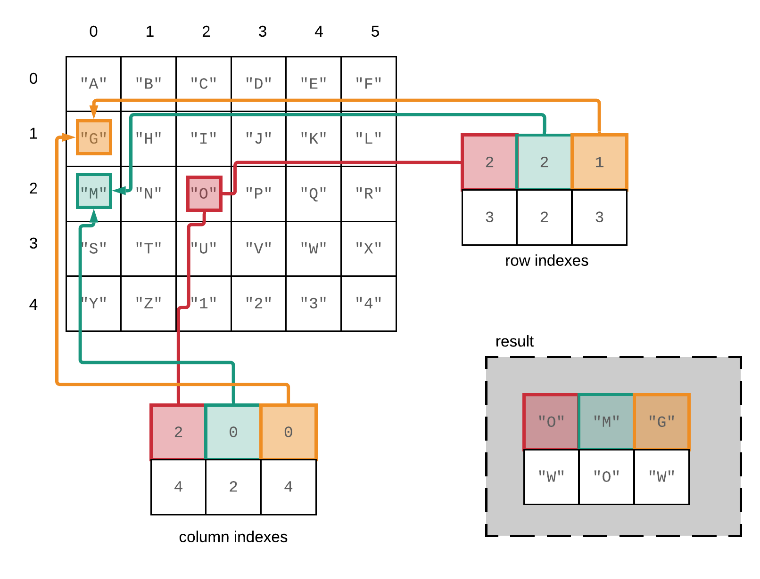
Fancy indexing in NumPy – reference slide

Slide 47


Operations that only change the metadata return a “view “ of the original memory block, otherwise a new memory block needs to be allocated, returning a “copy”
Live Coding
notebooks/NumPy/NumPy_views_and_copies.ipynb
Notes:
Two sets of operations
1.Only change metadata
2. New memory block is allocated → return a copy (we say)

Slide 48
NumPy views and copies
Live Coding
notebooks/NumPy/NumPy_views_and_copies.ipynb
View
accessing the array without changing the memory block
slicing gives views
in-place operations modify the memory block and all of its views
Copy
when a copy of an array needs to be created, it allocates a separate memory block and associates it with a new metadata
fancy indexing always gives copies
a copy can be forced by method .copy()

Slide 49
NumPy views and copies
View
accessing the array without changing the memory block
slicing gives views
in-place operations modify the memory block and all of its views
Copy
when a copy of an array needs to be created, it allocates a separate memory block and associates it with a new metadata
fancy indexing always gives copies
a copy can be forced by method .copy()
Exercise
exercises/view_or_copy/view_or_copy.ipynb

Slide 50
A special kind of view: broadcasting operations
Memory block
0 | 1 | 2 | 3 | 4 | 5 | 6 | 7 | 8
NumPy array metadata
dtype | int64
ndim | 2
shape | (4, 9)
strides | (0, 8)
The shape says we have 4 rows and 9 columns
A stride of 0 means that for each new row, we don’t move in memory
Notes:
Special case, when one of the strides is 0 → duplicates without occupying more memory
Transition, other operations that can
Braodcasting
Imagine what happens if we have a stride of 0
It allows us to replicate the sae row without allocating extra memory
What happens when it’s a 0?

Slide 51
A special kind of view: broadcasting operations
Memory block
As a result, we obtain a view with duplicated rows, without using extra memory!
0 | 1 | 2 | 3 | 4 | 5 | 6 | 7 | 8
NumPy array metadata
NumPy view
dtype | int64
ndim | 2
shape | (4, 9)
strides | (0, 8)
The shape says we have 4 rows and 9 columns
0 | 1 | 2 | 3 | 4 | 5 | 6 | 7 | 8
0 | 1 | 2 | 3 | 4 | 5 | 6 | 7 | 8
0 | 1 | 2 | 3 | 4 | 5 | 6 | 7 | 8
0 | 1 | 2 | 3 | 4 | 5 | 6 | 7 | 8
A stride of 0 means that for each new row, we don’t move in memory
Notes:
Stride == 0 → then we are not actually moving in memory, same memory, we are looping over the same thing

Slide 52
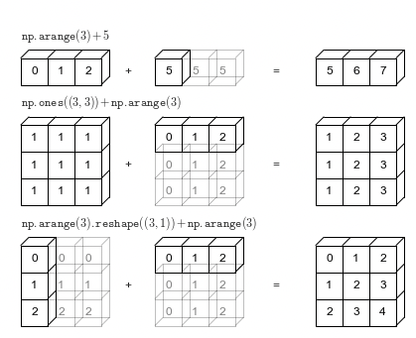
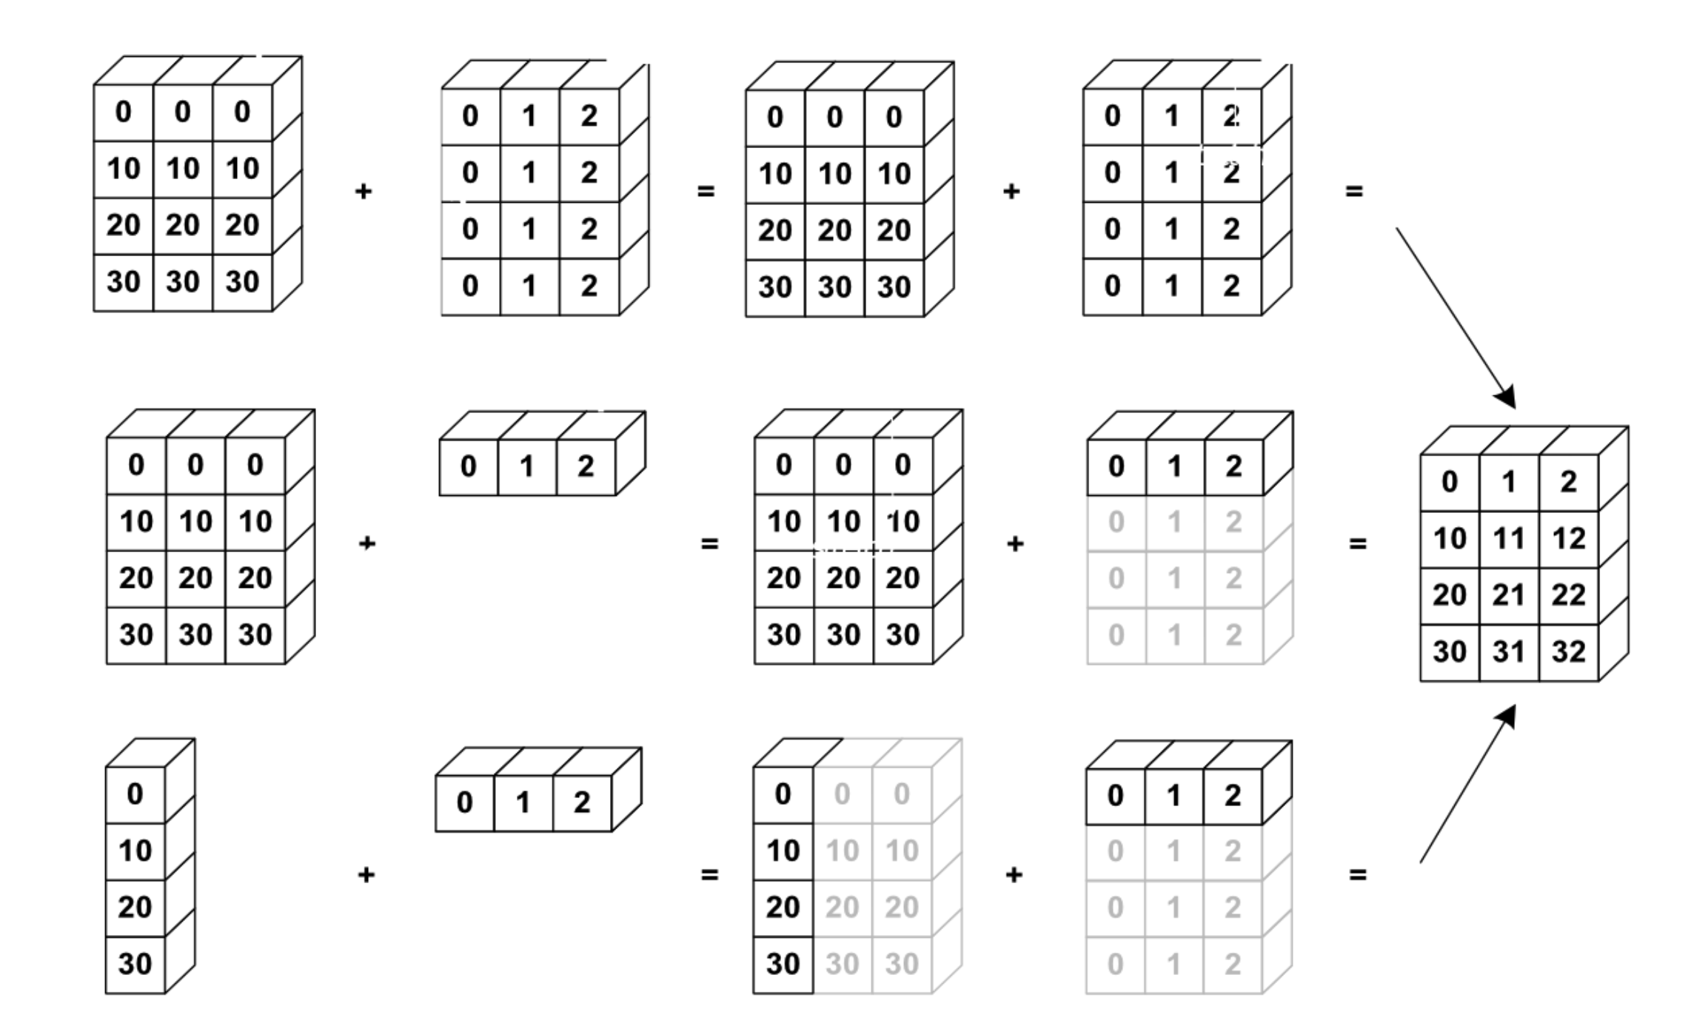
NumPy uses broadcasting to perform operation on arrays of different shape without having to allocate extra memory
Notes:
Again the kaleidoscope metaphor, it’s an aritifical way to replicate something

Slide 53
Broadcasting notebook summary
Dive in Broadcastig
notebooks/NumPy/broadcasting.ipynb
how NumPy treats arrays with different shapes during arithmetic operations
Rules of broadcasting
1: If the two arrays differ in their number of dimensions, the shape of the one with fewer dimensions is padded with ones on its leading (left) side.
2: If the shape of the two arrays does not match in any dimension, the array with shape equal to 1 in that dimension is stretched to match the other shape.
3: If in any dimension the sizes disagree and neither is equal to 1, an error is raised.
Notes:
Show 1,2 examples and the notebook with the rules/ their implementation

Slide 54


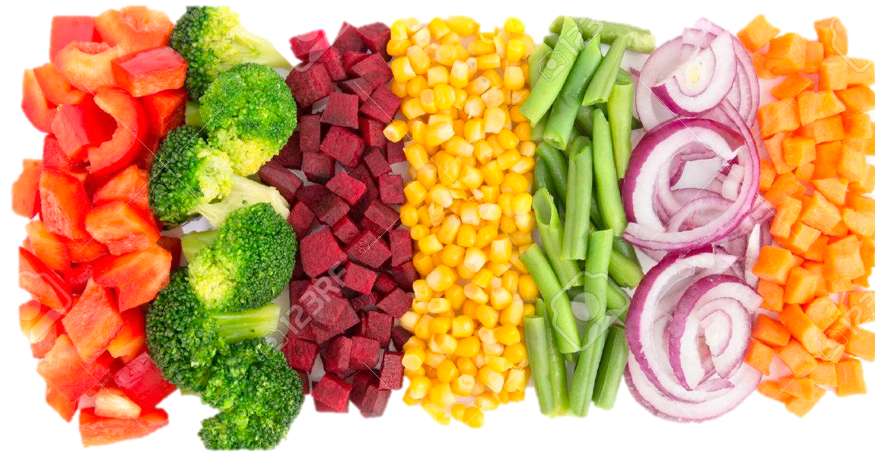
NumPy’s speed efficiency
Notes:
We don’t only need to look at the arrays but al
NumPy kaleidoscope on looking at the memory block → efficient operations
But we can also do stuff and not only look at the

Slide 55
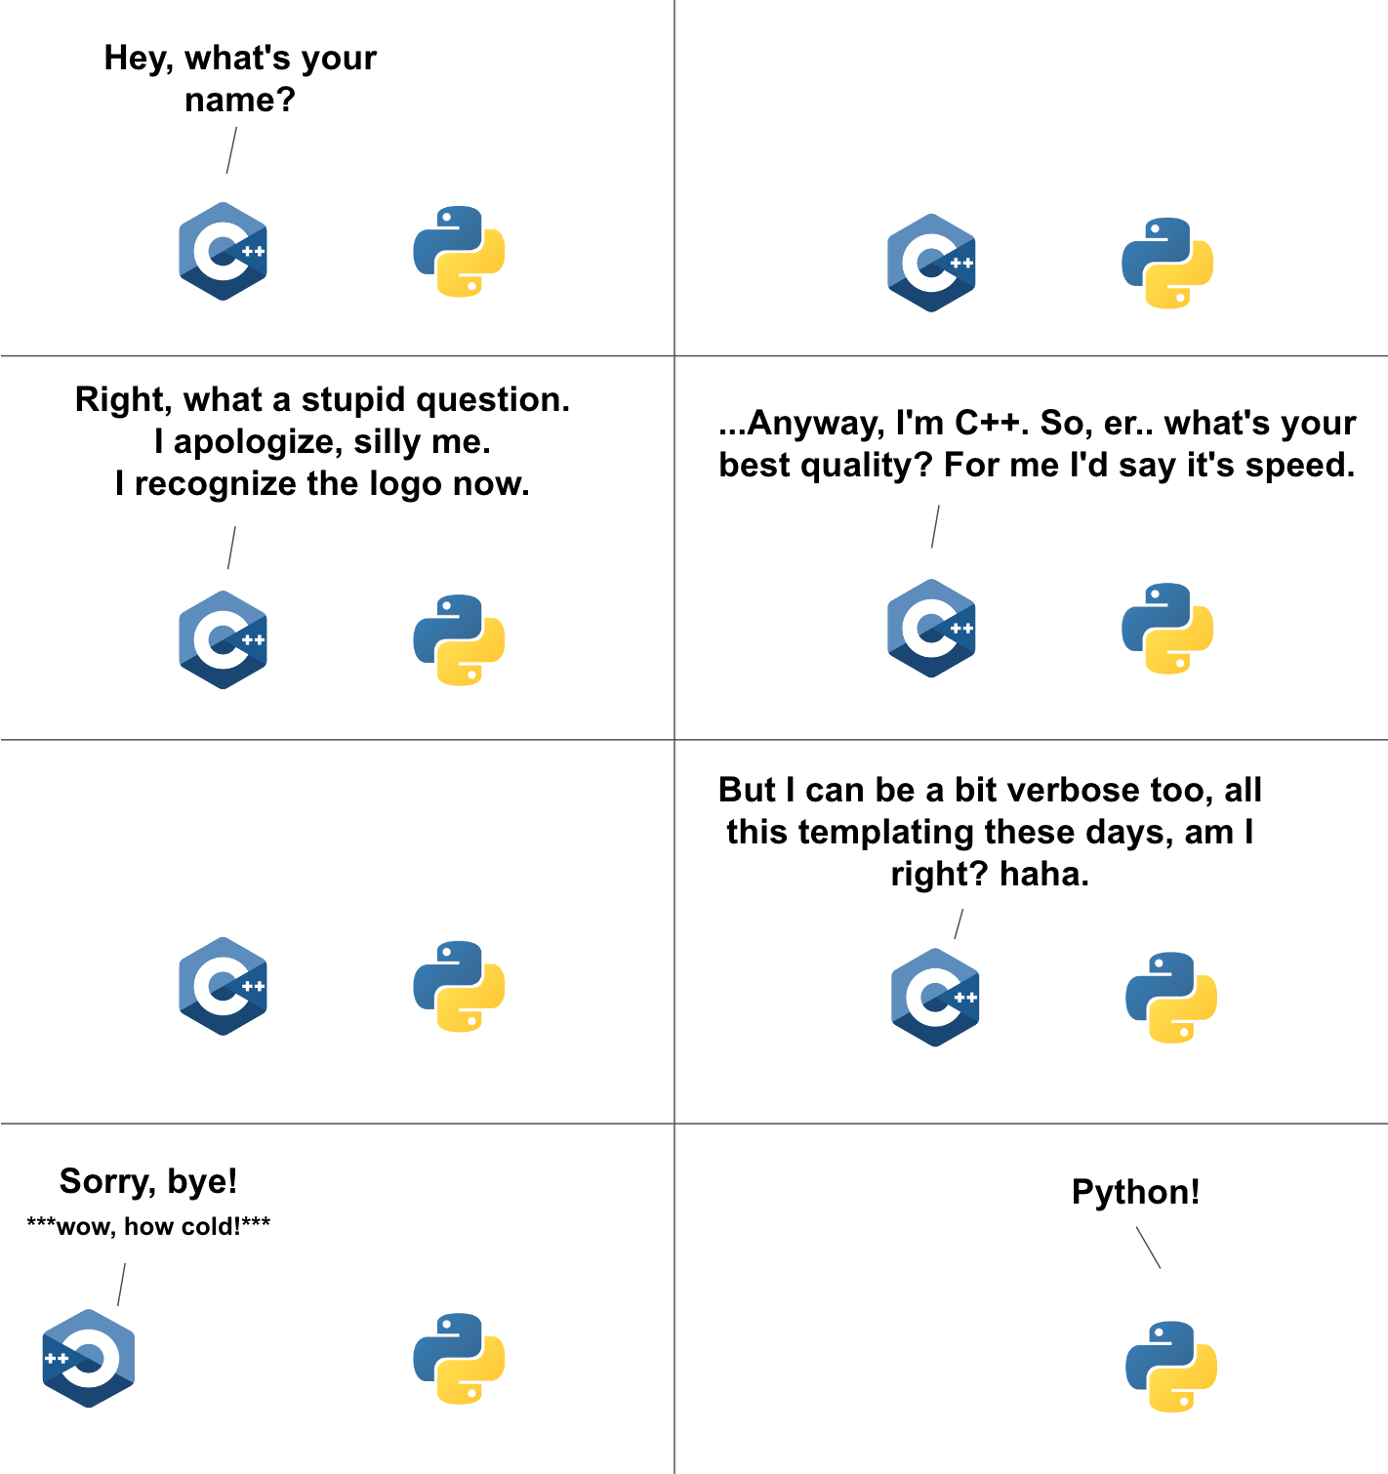
For-loops in Python vs in C
Data is of a C numerical type → regular layout in memory
A C loop can jump from one memory location to the next by moving by “strides” bytes and accumulating the result
To get that performance, one needs to vectorize! it’s important to avoid for-loops at all costs (with NumPy in Python)
Notes:
From memory block too
Режжелагин тхе отхер блаоцк боь
`
a = x[::2, 3]
a.sum()
start_memory_pos = a.data
a.dtype sum = 0
for i in a.shape[0]:
for j in a.shape[1]:
memory_pos = start_memory_pos + a.strides[0] * i + a.strides[1] * j
sum += cast_to(memory_pos, a.dtype)

Slide 56
Vectorization
operations performed on entire arrays at once
Faster computation
no looping through each element individually
Notes:
With many cases you can get away from using for loops by using those basic operatons or aggregation functions
Sometimes you’d need to be clever. E.g. use clever broadcaintg with meshgrid

Slide 57
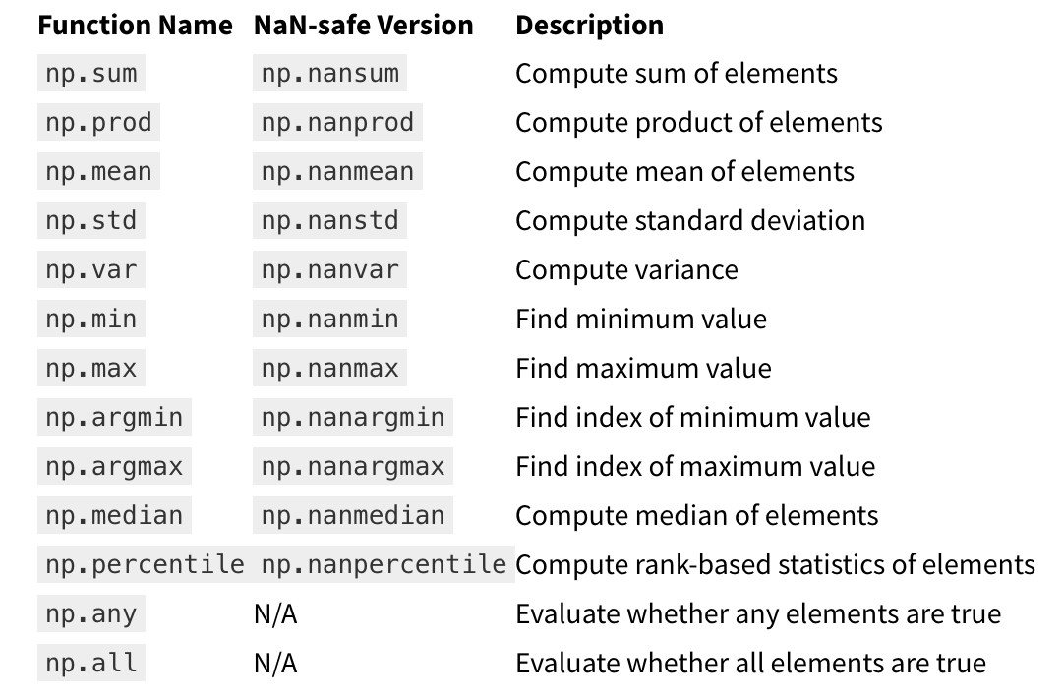
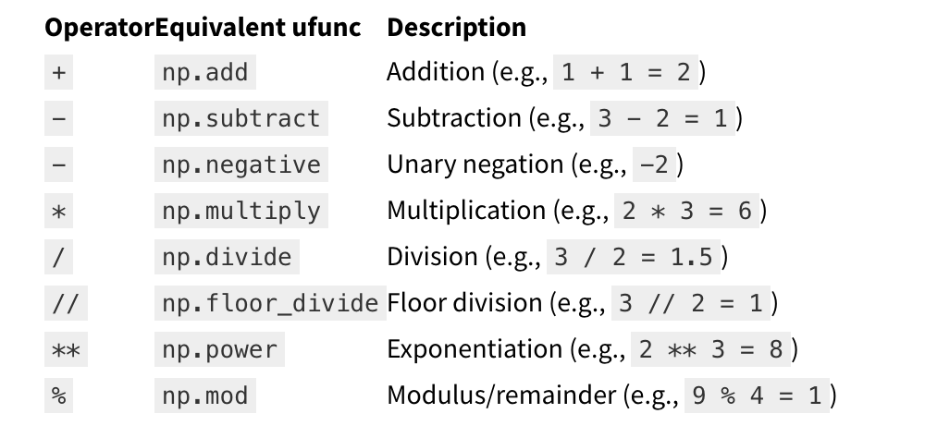
Vectorization
operations performed on entire arrays at once
Faster computation
no looping through each element individually
Aggregation functions
Basic operators
Notes:
With many cases you can get away from using for loops by using those basic operatons or aggregation functions
Sometimes you’d need to be clever. E.g. use clever broadcaintg with meshgrid

Slide 58
Exercise: vectorize the code
Exercise
exercises/numpy_vectorize
Open the notebook numpy_vectorize, and follow the instructions!
Submit a PR for Issue #8 on git.aspp.school/ASPP/2024-heraklion-data

Slide 59
For-loops in Python vs in C
Data is of a C numerical type → regular layout in memory
A C loop can jump from one memory location to the next by moving by “strides” bytes and accumulating the result
To get that performance, one needs to vectorize! it’s important to avoid for-loops at all costs (with NumPy in Python)
How is efficiency of Python vs C in the Big-O sense?
Notes:
From memory block too
Режжелагин тхе отхер блаоцк боь
Inefficient algorithms stay inefficient
a = x[::2, 3]
a.sum()
start_memory_pos = a.data
a.dtype sum = 0
for i in a.shape[0]:
for j in a.shape[1]:
memory_pos = start_memory_pos + a.strides[0] * i + a.strides[1] * j
sum += cast_to(memory_pos, a.dtype)

Slide 60

Tabular data

Slide 61

Spreadsheets and databases rule the world!
Ariel Fischman holds the Guinness World Record for owning the most spreadsheet software (over 500!)
https://techcommunity.microsoft.com/t5/excel-blog/guinness-world-records-the-largest-collection-of-spreadsheet/ba-p/216592

Slide 62
What is tabular data?
Unlike arrays, each column can represent another type of value, with different data types
Date (index) | Wind speed | Wind direction | Rain fall (mm) | Hours of sun
7.3.2024 | 7.1 | N | 0.0 | 10
8.3.2024 | 0.3 | NW | 2.1 | 2
9.3.2024 | 1.1 | SE | 0.3 | 5
Subject ID (index) | Condition ID | Presentation nr | Response time (ms) | Response
VM | 732 | 2 | 28 | LEFT
VM | 732 | 3 | 41 | RIGHT
PB | 665 | 1 | 73 | LEFT

Slide 63
What is tabular data?
Column and rows have meaningful labels (indices) that are attached to the data for each operation
Date (index) | Wind speed | Wind direction | Rain fall (mm) | Hours of sun
7.3.2024 | 7.1 | N | 0.0 | 10
8.3.2024 | 0.3 | NW | 2.1 | 2
9.3.2024 | 1.1 | SE | 0.3 | 5
Subject ID (index) | Condition ID | Presentation nr | Response time (ms) | Response
VM | 732 | 2 | 28 | LEFT
VM | 732 | 3 | 41 | RIGHT
PB | 665 | 1 | 73 | LEFT

Slide 64
Many tools to handle tabular data
Python tools
pandas: in-memory tabular data
dask: on-disk tabular data
SQL databases
Optimized for retrieving rows (tree data structure for index)
Transactional: groups of operations are either all executed, or none
Columnar DBs, Spark, Hadoop
Optimized for operations on columns
Ideal for data science tasks
Operations can be automatically distributed over multiple machines

Slide 65
Tabular data ideas and operations are universal for all tabular data tools
Pandas
df.groupby(‘condition_id’)[‘response_time’].mean()
dask
df.groupby(‘condition_id’)[‘response_time’].mean()
PySpark
df.groupby(‘condition_id’).avg(‘response_time’)
SQL
SELECT condition_id,
AVG(response_time) AS avg_response_time
FROM df
GROUP BY condition_id;

Slide 66
Introduction to Pandas
Live Coding
notebooks/030_tabular_data/ 010_pandas_introduction.ipynb

Slide 67
Introduction to Pandas
Live Coding
notebooks/030_tabular_data/ 010_pandas_introduction.ipynb
Main points:
A DataFrame is a tabular data structure
DataFrames have labeled columns and rows (“indices”)
Columns can be of different C-native dtypes
Operations are on columns by default
NaNs are interpreted as missing data and ignored in most operations
Strings (and dates) have a special accessor to perform vectorized string (or date) operations

Slide 68
Basic Pandas reference slide
Looking at data
df.head() : show the first 5 rows
df.tail() : show the last 5 rows
df.sample(n) : show n random rows
Attributes
df.shape : size of the table
df.dtypes : print dtype of cols
df.columns : column index
df.index : rows index
Indexing
df[‘age’] : get column ‘age’
df[[‘age’, ‘name’]] : multiple columns
df.iloc[0, 2] : one element, by position
Exploration
df[‘name’].unique() : unique values
df[‘age’].describe() : summary stats
df[‘age’].value_counts(dropna=False) : number of rows per unique value in column
Adding a column
df[‘new’] = df[‘age’] * 3.1 : add new column
Filtering
df[df['age'] > 30] : select rows where condition is True
Operations
df.min(), .max(), .mean(), .std(), etc. : column-wise operations
df.count() : count of non-NaN elements in columns
df.sort_values(‘name’) : reorder rows by values of column ‘name’
df.sort_index() : reorder rows by the index values
String operations
df[‘name’].str : accessor for operations on the strings in a col
df['name'].str[2:4] : slice the strings in a col
df['name'].str.count(‘a’) : count the letter ‘a’ in the string in a col

Slide 69

Tabular data example from the lab
Research question: Does neuronal activity change over time? Does this depend on the overall activity level of the neuronal network? The mainstream theory suggests that neural activity is self-regulating to maintain a baseline level (“homeostatic plasticity”)
Exp design: patch clamp recordings from the same cells (or different cells/ same slices) before and after prolonged incubation in high potassium (K)
Potassium stimulates and TTX silences the entire network, allowing us to control the overall activity

Slide 70
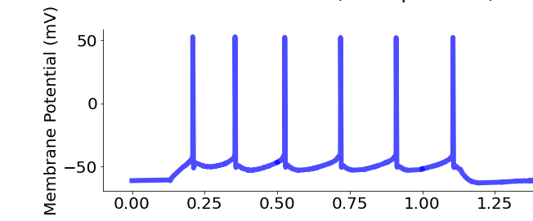
Variables
Applied Current
300 pA
Day 1 (D1)

Slide 71
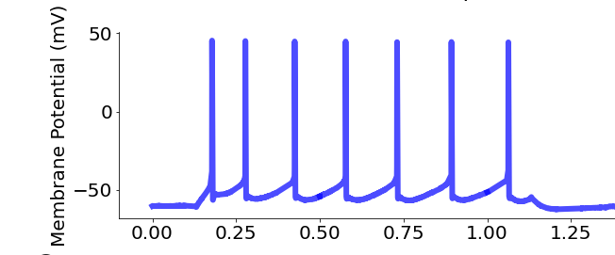
Variables
Applied Current
300 pA
Day 1 (D1)
Day 2 (D2)

Slide 72
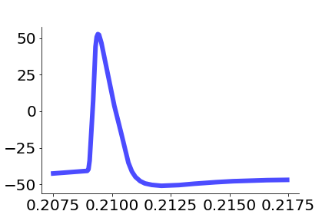
Variables
Day 1 (D1)
mV
Day 2 (D2)
Time (seconds)

Slide 73
Variables
Action potential (AP) properties
resting_potential = -74.3 mV
* *. *. * * *
max_spikes = 6
max_repol =
-91.4 mV/ms
Day 1 (D1)
AP_heigth
= 92.2 mV
mV
AP_halfwidth
= 0.91 ms
max_depol =
377.4 mV/ms
Day 2 (D2)
TH =
-39 mV
Time (seconds)
Time (seconds)

Slide 74
Hands-on Let’s have a look at the neural data
Exercise
exercises/pandas_intro
Use Pandas to explore the neural data
Submit a PR for Issue #2 on git.aspp.school/ASPP/2024-heraklion-data

Slide 75
TABULAR DATA OPERATIONS

Slide 76
Common operations on tabular data
Tabular data has additional needs compared to arrays. Understanding how to vectorize these operations is critical for handling them
Combine information across tables (join, anti-join)
Join: e.g., combine table with experiments results with table with experiments metadata (date, location, experimenter, free-form notes, …)
Anti-join: e.g. student compiles list of outliers, exclude them from the table of experiments to analyze
Summary tables (split-apply-combine)
E.g., compute average measurement and standard deviation by experimental condition and treatment dosage
Window functions to vectorize complex computations over groups
E.g., compute the time distance between experiments by lab technician

Slide 77
Joins

Slide 78
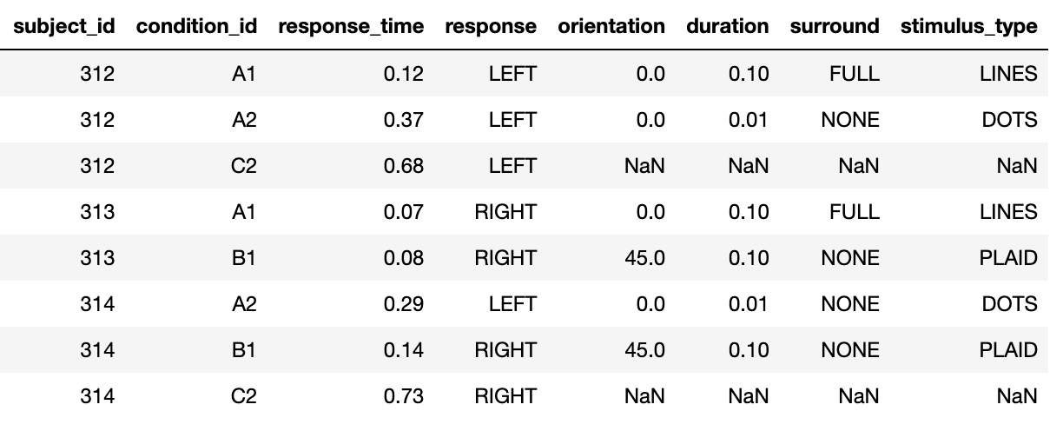
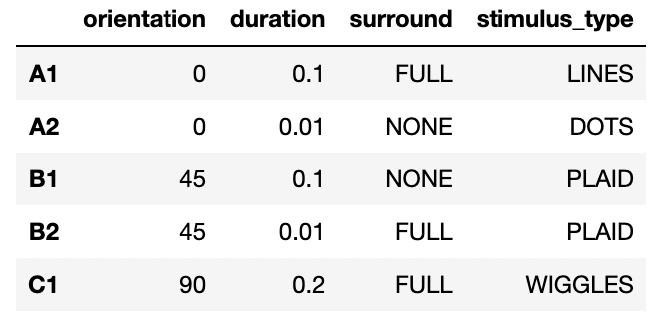
Join operations: combining informations from multiple tables
+
=

Slide 79
Join operations
Live Coding
notebooks/tabular_data/
020_join_operations.ipynb

Slide 80
Join operations
Live Coding
notebooks/tabular_data/
020_join_operations.ipynb
Main points:
Join operations can be used to combine two tables using the values of one or more columns
Different types of join:
left/right: keep all the column values that are present in the first/second table
inner: keep all the column values that are present in both tables
outer: keep all the column values that are present in one or the other tables
Anti-joins can be used to exclude the values that are present in one, but not the other table (filtering based on arbitrary criteria)

Slide 81
Hands-on
Exercise
exercises/tabular_join
Use joins to add experiment information to the neural data
Use anti-joins to remove outliers
Submit a PR for Issue #3 on git.aspp.school/ASPP/2024-heraklion-data

Slide 82
Split-apply-combine

Slide 83
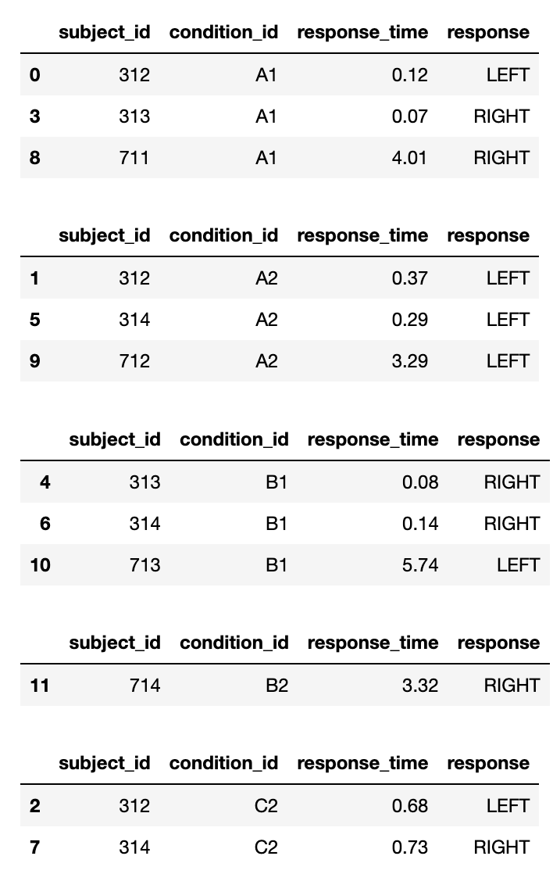
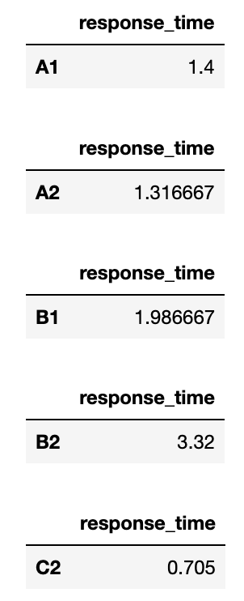
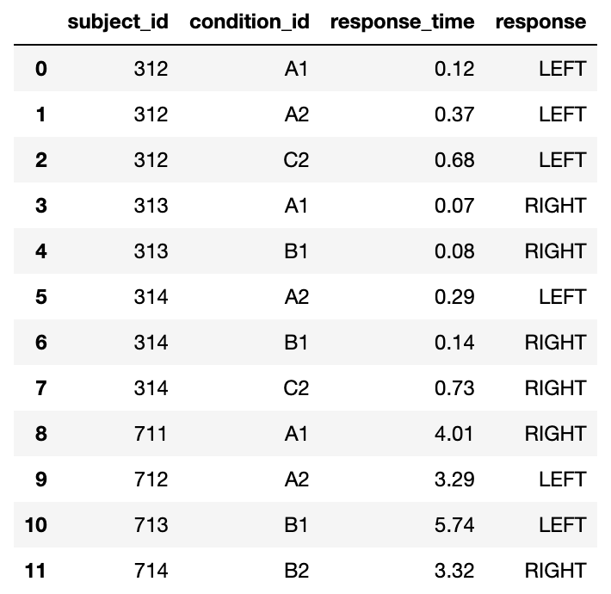
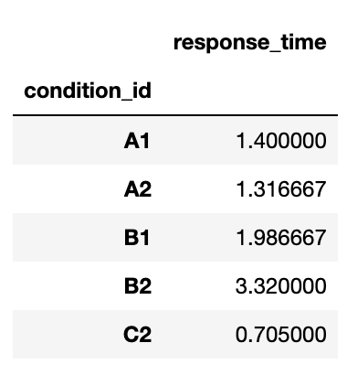
The basic structure of most numerical analyses
split
apply
combine
A1
A2
mean
B1
B2
C2

Slide 84
Split-apply-combine operations
Live Coding
notebooks/030_tabular_data/
030_split-apply-combine.ipynb

Slide 85
Split-apply-combine operations
Live Coding
notebooks/030_tabular_data/
030_split-apply-combine.ipynb
Main points:
Tabular data tools have a way to vectorize the standard split-apply-combine operations, using a “group-by” command
In addition, Pandas has got a “pivot-table” command that can be used to simplify the creation of more complex summary tables

Slide 86
df.groupby(‘condition_id’)[‘response_time’].mean()
split
apply
combine
A1
A2
mean
B1
B2
C2

Slide 87
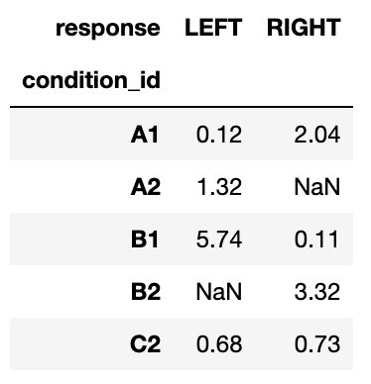
data.pivot_table( index='condition_id', columns='response', values='response_time', aggfunc='mean',
)
split
apply
combine

Slide 88
Hands-on
Exercise
exercises/ tabular_split_apply_combine
Compute summary statistics for the neural data
Submit a PR for Issue #4 on git.aspp.school/ASPP/2024-heraklion-data

Slide 89
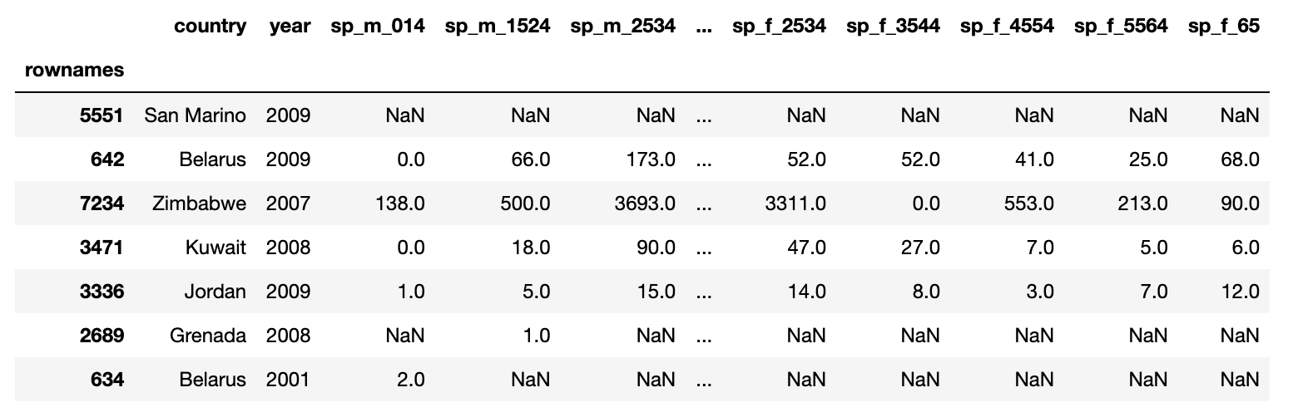
Hands-on
Exercise
exercises/tuberculosis
Compute some summary tables for the WHO tuberculosis data
Males
15-24 years

Slide 90
Tidy Data

Slide 91
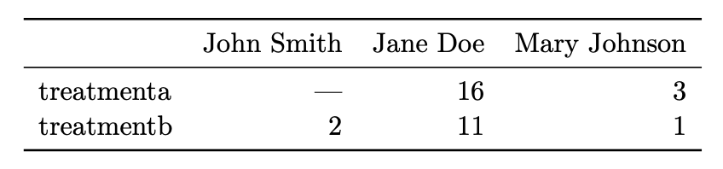
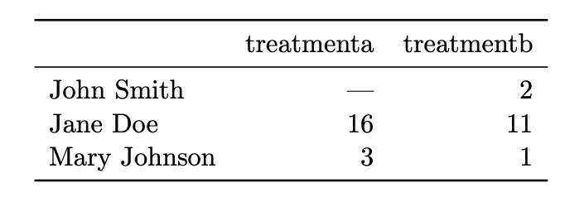
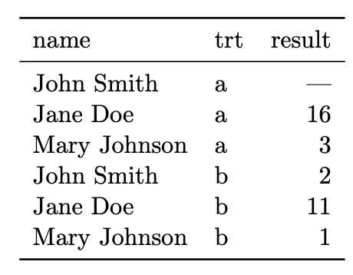
Same data, different organization Which one is best for data analysis?

Slide 92
Same data, different organization Which one is best for data analysis?
What do we want?
We want data to be in a natural format, such that data analysis is easy

Slide 93
Tidy data
In tidy data:
1. Each variable forms a column 2. Each observation forms a row 3. Each type of observational unit forms a table
Variables (or features, attributes)
Variables increase when new types of measurements are introduced
Subject ID | Condition ID | Trial nr | Response time (ms) | Response
VM | 732 | 2 | 28 | LEFT
VM | 732 | 3 | 41 | RIGHT
PB | 665 | 1 | 73 | LEFT
Observations (or samples)
Observations increase when new units (dates, subjects, …) are measured

Slide 94
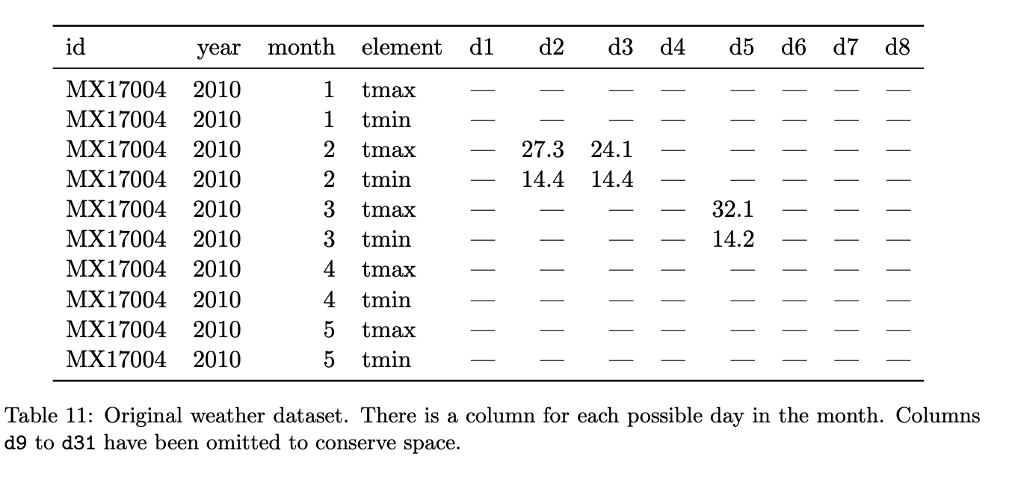
Hands-on
Identify variables, observations, and values. What would a tidy version look like?

Slide 95
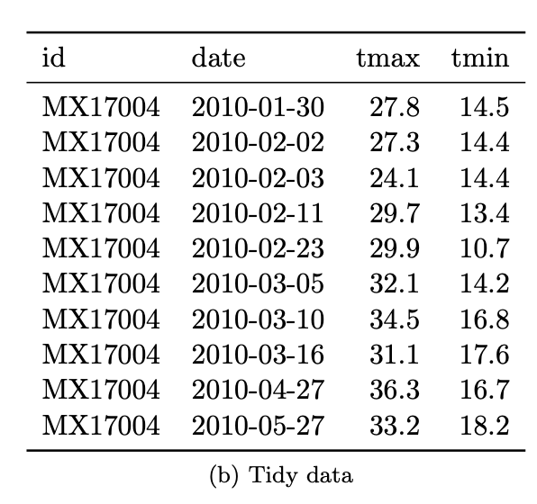
Hands-on
Identify variables, observations, and values. What would a tidy version look like?

Slide 96
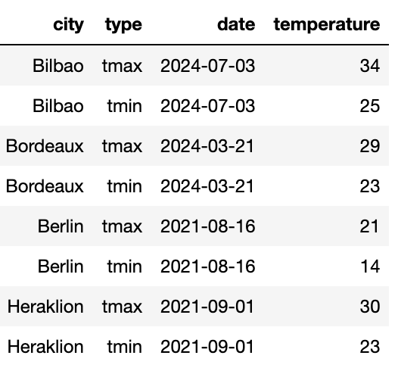
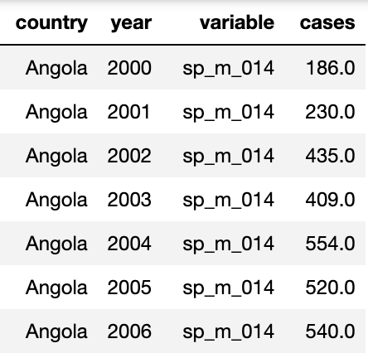

Messy data
“Tidy datasets are all alike but every messy dataset is messy in its own way” – Hadley Wickham
Variables are stored in both rows and columns
Some variables are stored in the file names
😱
😱
Multiple variables are stored in one column
Column headers are values, not variable names
2024-01_prices_DE.csv 2024-01_prices_FR.csv 2024-02_prices_DE.csv 2024-02_prices_FR.csv
😱
😱

Slide 97


The life-changing magic of tidying up data
Pivoting – we know this one
The “type” column is storing variable names
😱
pivot
df.pivot_table( index=['city', 'date'], columns='type’, values='temperature', aggfunc='max’,
)

Slide 98


The life-changing magic of tidying up data
Melting – it’s kind of the opposite of pivoting
The treatment values are stored as a column name
😱
melt
pd.melt(data, id_vars=['subject', 'date'], value_name='response_time')
Split the columns in (A) “id_vars” and (B) non-”id_vars”. The column names in (B) are used as new values in a new column “variable”. The values in columns (B) go into a new column, “response_time”.

Slide 99

The life-changing magic of tidying up data
pd.concat – add together tables with the same variables (columns)
Some variables are stored in the file names
tables = []
for filename in filenames:
# Parse filename
year_month, _, country = filename[:-4].split('_')
# Read table and add columns for the variables
df = pd.read_csv(filename)
# Add the variables that were in the filename
df['year_month'] = year_month
df['country’] = country
# Store table
tables.append(df)
# Create complete table
tidy_df = pd.concat(tables)
😱
2024-01_prices_DE.csv 2024-01_prices_FR.csv 2024-02_prices_DE.csv 2024-02_prices_FR.csv

Slide 100
Hands-on
Exercise
exercises/tabular_tidy_data
Tidy up the data set in the tuberculosis exercise and compute the summary stats
Submit a PR for Issue #5 on git.aspp.school/ASPP/ 2024-heraklion-data
Multiple variables are stored in one column
😱

Slide 101

Why is tidy data good?
Many analyses require a simple sequence of steps:
Filter by individual variables to discard data that is not needed
Group and summarize
Re-arrange (e.g. sort)
Visualize
Joining tidy tables is easy!
One can write generic code that takes tidy data as input. For example, seaborn relies on tidy data to make complex plots
sns.swarmplot(
data=df,
x="body_mass_g",
y="sex",
hue="species”,
)

Slide 102
Window functions

Slide 103
Window functions: grouped row-by-row operations
“Window functions” are a kind of split-apply-combine operation, but instead of aggregating the data in a group and returning one value per group, they return one value per row
Examples: ranking all entries in a group; computing the distance between timestamps per group; number the rows by group in chronological order
In Pandas, most of these operations can be performed with a combination of sorting and grouping-by

Slide 104
Window functions
Live Coding
notebooks/tabular_data/
040_window_functions.ipynb

Slide 105
Window functions
Live Coding
notebooks/tabular_data/
040_window_functions.ipynb
Main points:
Window functions perform row-by-row operations on grouped data
They are an advanced way of avoiding for loops with tabular data
In Pandas, they can be achieved with a combo of sorting and grouping-by

Slide 106




Window functions operations
df['nr_lefts'] = df.sort_values('time (ms)').groupby('subject_id')['is_left'].cumsum()

Slide 107
Hands-on
Exercise
exercises/
tabular_window_functions
Compute the average number of days each patcher waited between experiments
Submit a PR for Issue #6 on git.aspp.school/ASPP/2024-heraklion-data

Slide 108
Global summary
There are many different data structures, each specialized in efficiently processing one type of data
Code performance grows differently with data size: Big-O
NumPy array efficiently store data in a C-native memory block, interpreted as an array using some metadata
NumPy operations that only need to change the metadata do so, creating a view of the same memory block. These operations are O(1)!
Tabular data can also be vectorized using joins, anti-joins, split-apply-combine operations, and window functions
For these operations to be efficient and painless, data should be stored in a tidy data format

Slide 109



What we didn’t talk about
Other data structures: graphs, trees, priority queues, …
Options for working with large data on disk / remotely (instead of in-memory)
Best practices in data handling: versioning, lineage, sharing
Organizing a complex data set in multiple tables
… and a lot more!

Slide 110

Thank you!

Slide 112
Data organization
Data organization concepts:
tidy data
normalized data (star organization)
data science friendly data (denormalized)

Slide 113

Organizing multiple tables
Dimension vs fact tables
De-normalization (but for data analys flat tables are more convienent)

Slide 114
Dealing with changes in the data
Recommendations:
NEVER overwite a data file. Treat data files as immutable
Use versioning for changes in the data file, and load the latest version for new analyses, old versions to reproduce previous results
(pond is a library I’m working on to automatize this process)
Like in computer code:
Adding new columns / rows is generally ok
Deleting/changing a column is not! Code will break! Add a new column instead

